Slide 1
Vestibular tests

Slide 2
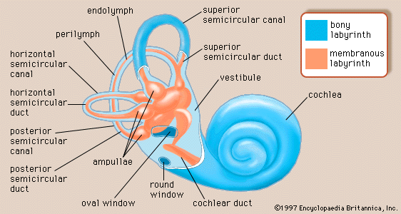

Slide 3
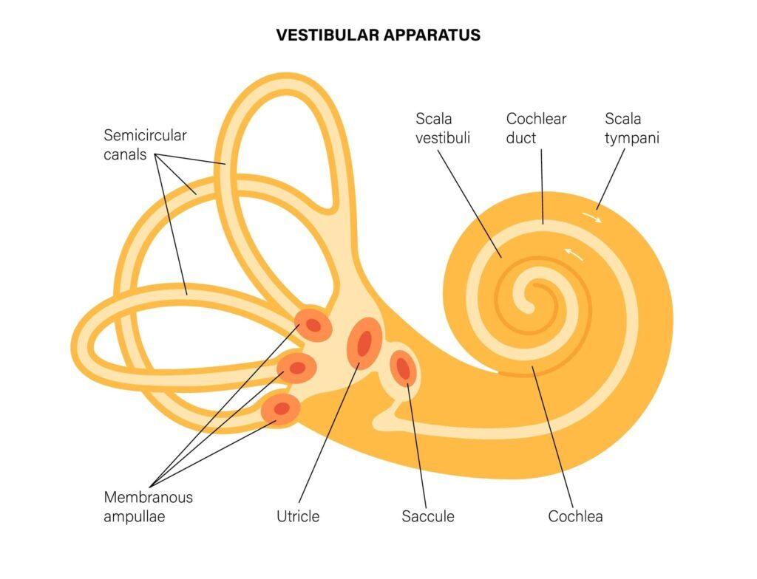
The Vestibular Apparatus
Together with the visual and kinesthetic analyzers, the vestibular apparatus contributes to maintaining both static and dynamic balance, as well as to spatial orientation of the individual.
Main functions:
Informing the central nervous system about the action of linear and angular acceleration forces;
Coordinating various complex body movements through continuous control of skeletal muscle tone.

Slide 4

Any lesion of the vestibular labyrinth apparatus or of the nerve may cause hyperexcitability, hypoexcitability, or inexcitability and leads to the appearance of the following symptoms:
Vertigo
Nystagmus
Balance disorders
Locomotor disturbances
Segmental deviations of the upper limbs and the head

Slide 5
Vestibular tests
Spontaneous tests (without labyrinth stimulation):
Outstretched arms test
Pointing test
Romberg test
Babinski–Weill test
Provoked tests (stimulating the labyrinth):
Pneumatic test
Caloric test
Rotational test

Slide 6
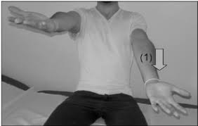
Spontaneous tests
Outstretched arms test: The patient extends their arms forward, parallel and horizontal, with both index fingers pointing at the examiner’s fingers, and keeps their eyes closed for 2 minutes. In the case of a lesion, the arms will deviate toward the hypofunctional (less excited) labyrinth.

Slide 7
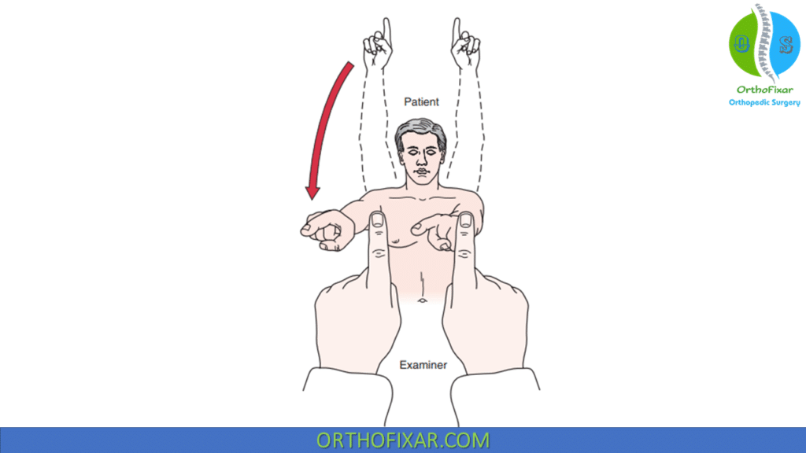
Pointing test: The patient keeps the arm extended and moves it in a vertical plane (for detecting horizontal deviations) or in a horizontal plane (for vertical deviations). In case of imbalance, the hand will deviate laterally or upward depending on the movement plane.

Slide 8
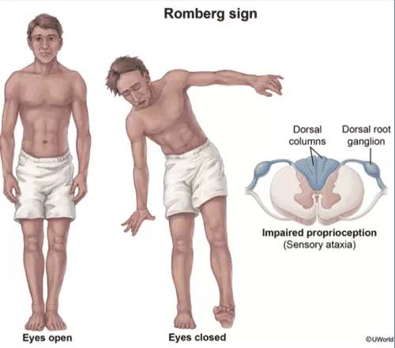
Romberg test: The patient stands upright with feet together, eyes closed, and arms alongside the body for 2 minutes. In the case of a labyrinthine lesion, the patient will sway with a tendency to fall—or may actually fall—toward the side of the hypofunctional (less responsive) labyrinth.

Slide 9
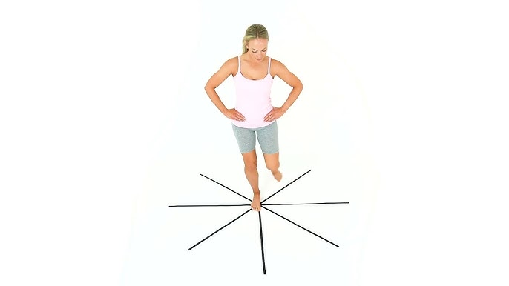
Babinski–Weill test (or star-walking test):
The patient, with eyes closed, takes 5 steps forward and 5 steps backward, repeating the movement 5 times.
During forward walking, the patient will deviate with each step toward the hypofunctional labyrinth, and during backward walking, toward the hyperfunctional one — resulting in a star-shaped walking pattern.

Slide 10
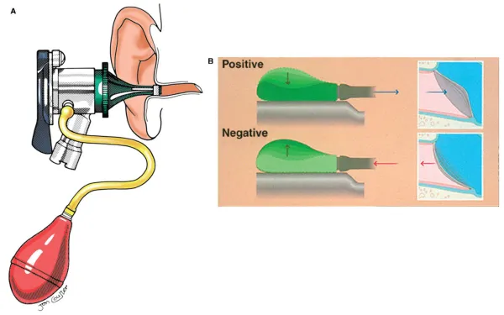
Provoked Vestibular Tests
Pneumatic test: Using a Siegle speculum or a Politzer bulb, a jet of air is insufflated onto the tympanic membrane, or air is aspirated from the external auditory canal. The purpose is to check for the appearance of nystagmus (normally, this test should not produce any pathological reaction).

Slide 11
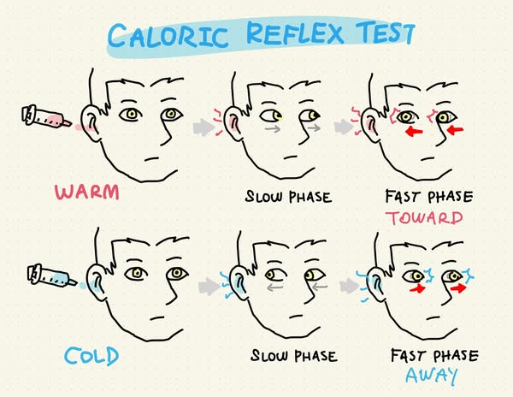
*
Caloric test: Using a Guillon syringe, the ear is irrigated with 100 ml of cold or warm water.

Slide 12
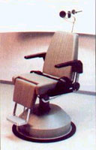
Rotational test: The patient is seated on a chair with the head flexed at 30 degrees to bring the horizontal semicircular canals into a horizontal plane. Then, 10 rotations are performed within 20 seconds, after which the chair is suddenly stopped.

Slide 13
Special Rotational Tests :
Electronystagmography (ENG) is one of the fundamental methods used in most vestibular examinations. It involves the graphic recording of nystagmus during lateral deviation of the eye. Eye movement is recorded using an electrode attached directly to the patient’s skin.

Slide 14
Videonystagmography (VNG):
This is performed using special goggles equipped with a miniature video system and an infrared light source.
The goggles record the horizontal, vertical, and rotational movements of the eyes and the patient's head during examination.
Because it does not require electrodes, this method is indispensable in cases where nystagmus cannot be detected using electronystagmography.

Slide 15
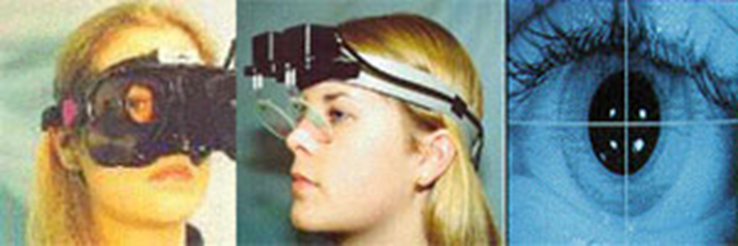
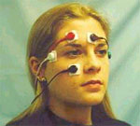

Slide 16
Posturography (Stabilography): This method is used to assess the condition of a patient's vestibular reflexes.
The examination is performed on a movable platform according to a preset program (dynamic computerized posturography). Through redistribution of muscle tone, the patient attempts to maintain balance. The tests have varying degrees of difficulty.
This method enables the evaluation of the integration of the visual, vestibular, and muscular systems with the aim of maintaining balance and conducting patient rehabilitation through special programs tailored to individual characteristics, personality, and the severity of the condition.

Slide 17
